Slide 1

The Generative AI Revolution: A Month-Long AI Exploration
Level 2 | Apr 2024 | Week 1 Day 1

Slide 2

π
Generative AI
π

Slide 3
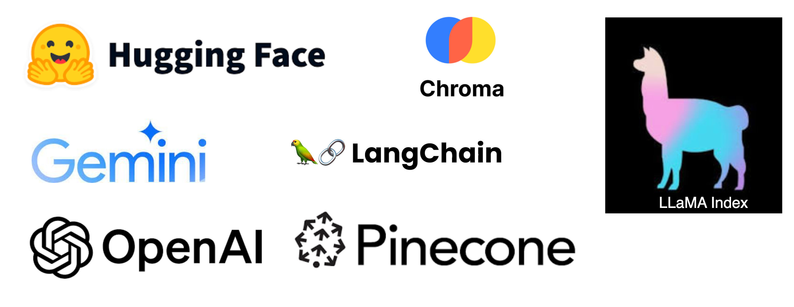
π
Tools We will cover?

Slide 4
π
Limitations of Prompt Engineering
What is Prompt Engineering:
Prompt engineering involves crafting specific input instructions or prompts to guide the output generation of AI models.
Limitations of Prompt Engineering:
Token Limitation
Hard to give detailed instructions in a small space.
AI might misunderstand or make things too simple, creating wrong or unhelpful stuff.
Knowledge Cutoff
At Risk from Tricky Inputs
Mean prompts can fool the AI into making bad or biased stuff.
We need strong ways to stop and fix these sneaky attacks.

Slide 5
π
Retrieval Augmented Generation
What is RAG ?
High Level Design
Step by Step Approach
What Problems RAG can resolve
π

Slide 6
π
RAG – What is RAG?
It's a technique that improves the accuracy and reliability of large language models (LLMs) by allowing them to access and leverage information from external knowledge sources.

Slide 7
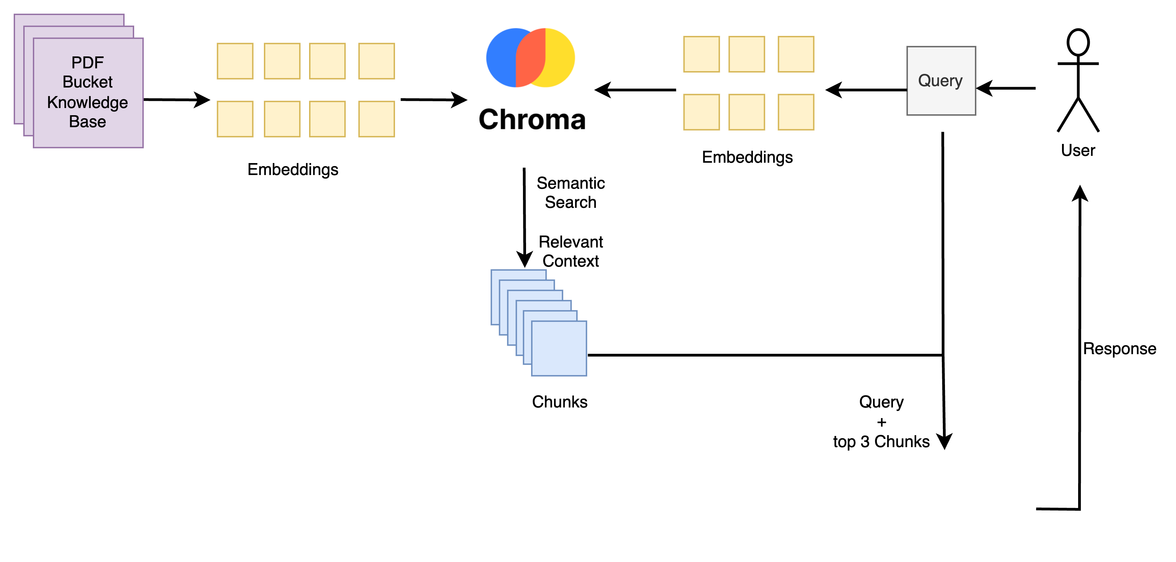

π
RAG – High Level Design

Slide 8
π
RAG – What problems RAG can Resolve?
Prompt Token Limitation
Knowledge Cut off limitation
Cost
Accuracy

Slide 9
π
RAG – Step by Step Approach
Chunking
Embedding
Vector DB
Semantic Search
Generative Search

Slide 10
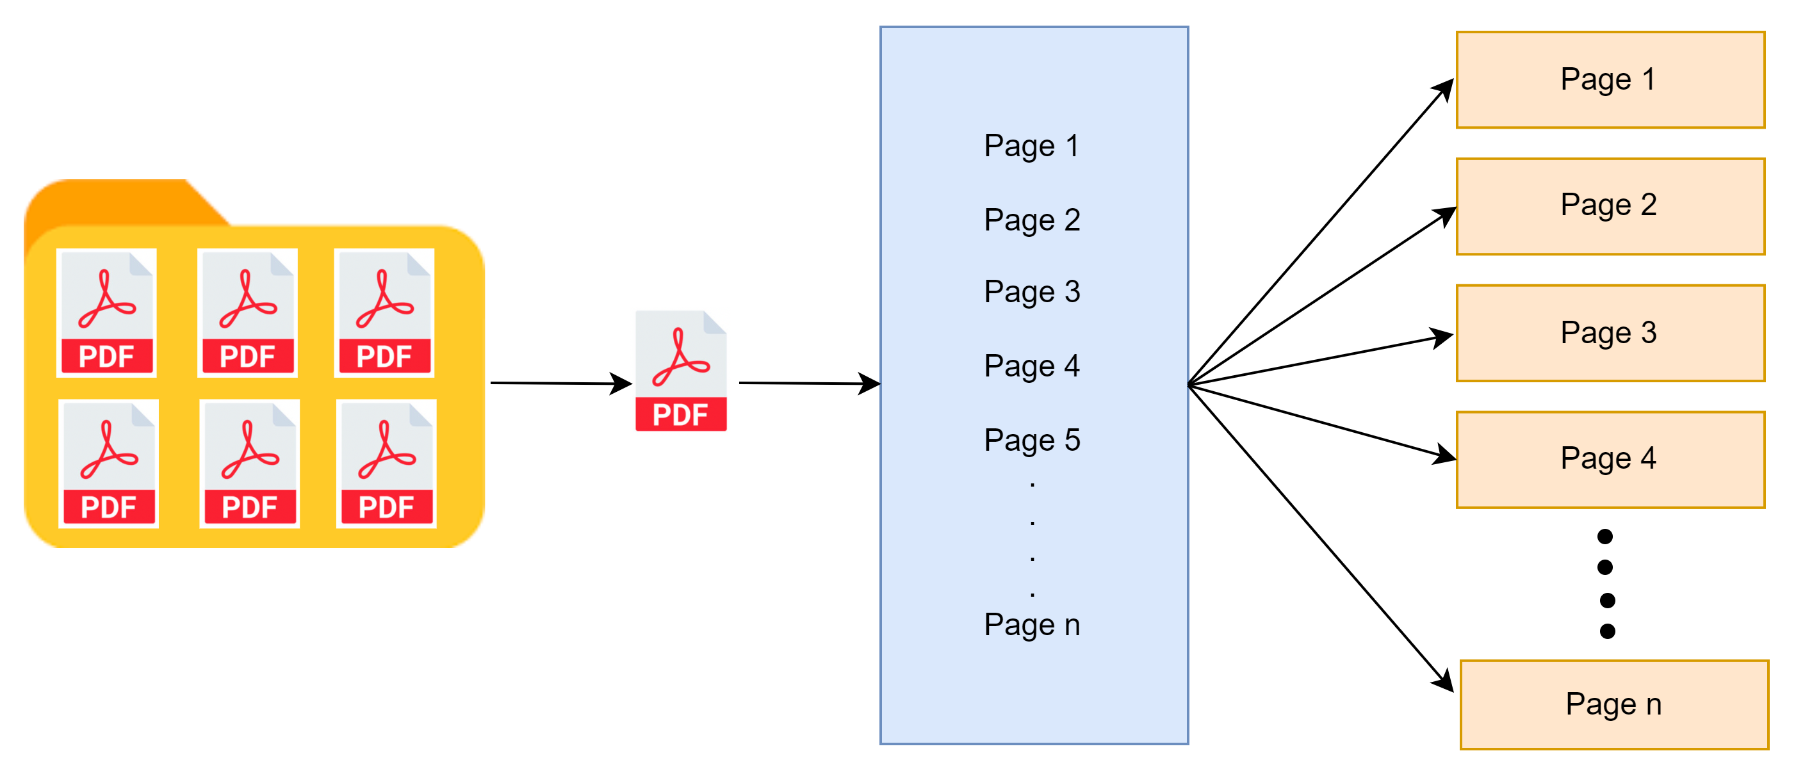
π
Chunking:
Reference: https://www.pinecone.io/learn/chunking-strategies/
Notes:
Modify this diagram

Slide 11
π
Chunking:
In the context of information processing, chunking refers to the practice of dividing larger pieces of data, text, or information into smaller, manageable units, or "chunks
Chunking strategy for data are:
Fixed-Length Chunking
Sentence or Paragraph Chunking
Page Chunking
Notes:
Modify this diagram

Slide 12
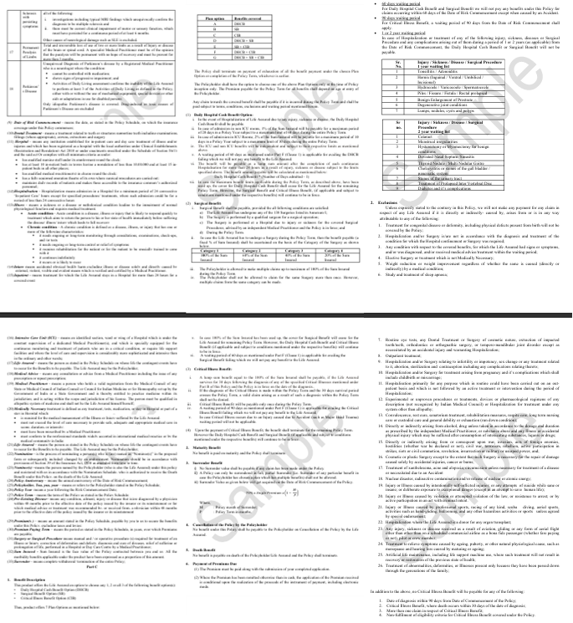
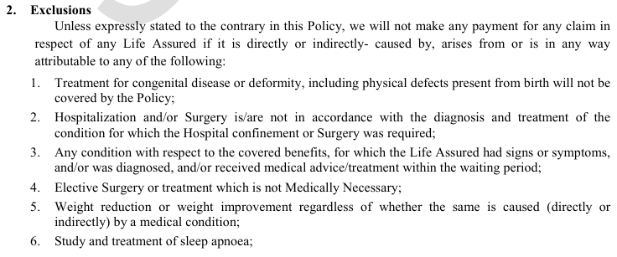
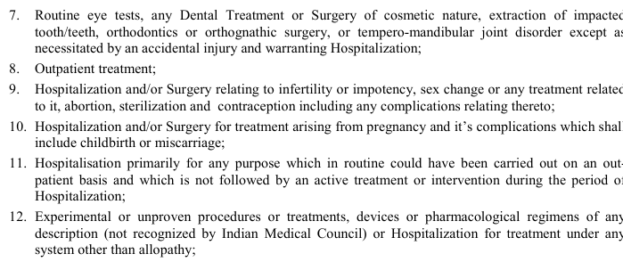
π
Fixed-Length Chunking
Notes:
Modify this diagram

Slide 13
π
Fixed-Length Chunking
Description: Splits text into chunks of a predetermined number of words, characters, or bytes.
Example Use Case: Analyzing social media posts for sentiment analysis.
Advantages: Simplicity and uniformity in chunk size.
Disadvantages: Potential context loss, as chunks may end mid-sentence or mid-thought.
Notes:
Content: https://www.linkedin.com/pulse/chunking-strategies-ai-data-kash-kashyap-0lghe/
Code: https://medium.com/@thallyscostalat/chunking-strategies-optimization-for-retrieval-augmented-generation-rag-in-the-context-of-e47cc949931d

Slide 14
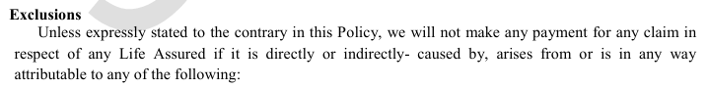
π
Example: Sentence Chunking:
Notes:
Modify this diagram

Slide 15
π
Sentence or Paragraph Chunking
Description: Breaks text into chunks based on natural language structures like sentences or paragraphs.
Example Use Case: Document summarization or content analysis tasks, such as processing news articles or academic papers.
Advantages: Maintains linguistic integrity, keeping sentences and paragraphs intact.
Disadvantages: variable chunk sizes which can be challenging to manage in some models.
Notes:
Content: https://www.linkedin.com/pulse/chunking-strategies-ai-data-kash-kashyap-0lghe/

Slide 16
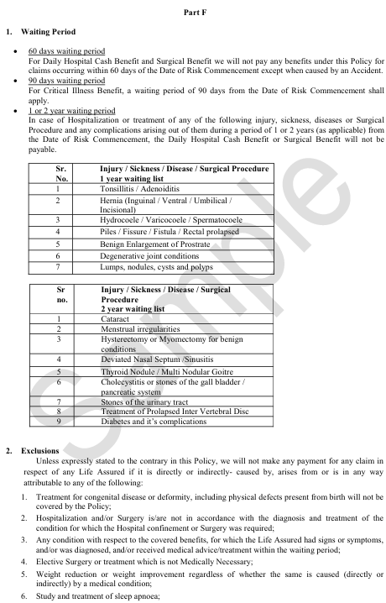
π
Example: Page-based Chunking:
Notes:
Modify this diagram

Slide 17
π
Page-based Chunking
Description: Dividing a PDF document into distinct pages to facilitate focused text processing and analysis at the page level.
Example Use Case: Complex tasks like document The summaries can then be combined to provide an overview of the entire document, making it easier for users to grasp the main points without having to read the entire content in detail.
Advantages: By using this strategy we can enable parallel processing of individual pages.
Disadvantages: In this strategy we may Loss Cross-Page relationship and another major disadvantage is Potential Context Disruption
Notes:
Content: https://www.linkedin.com/pulse/chunking-strategies-ai-data-kash-kashyap-0lghe/

Slide 18
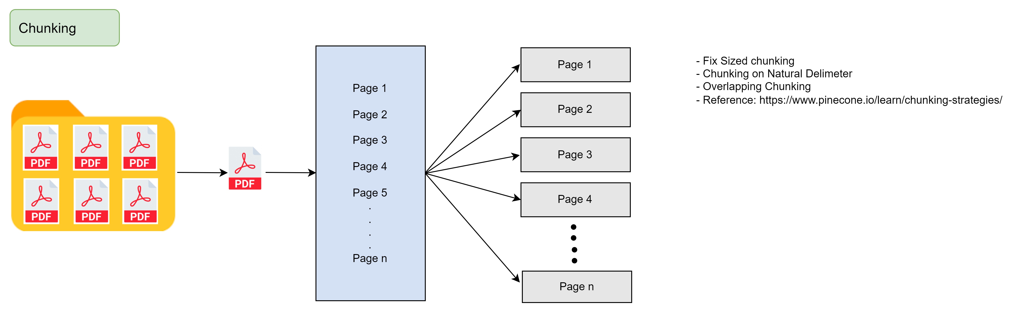
π

Slide 19
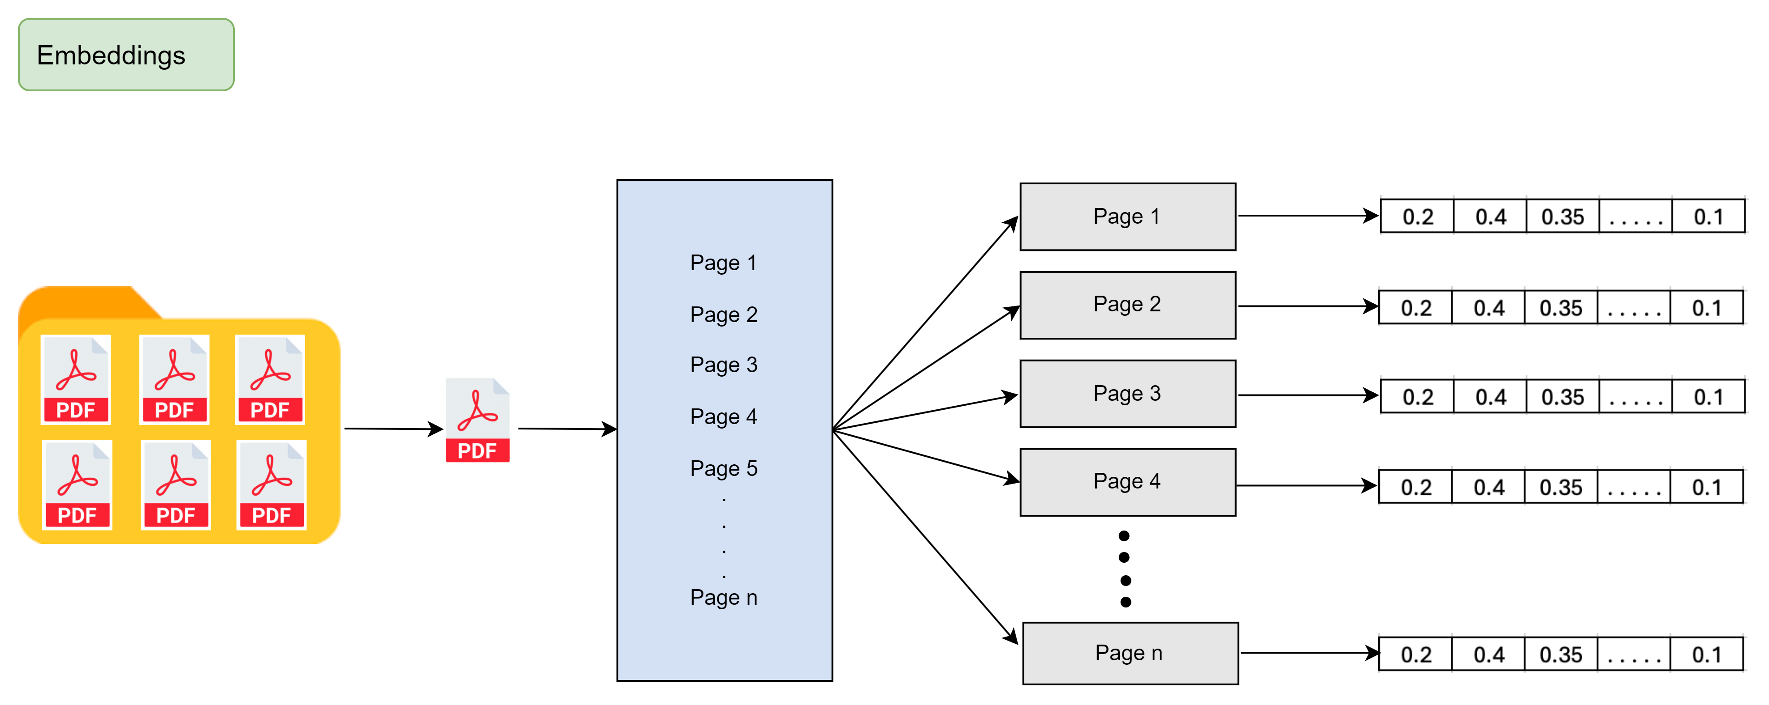
π

Slide 20
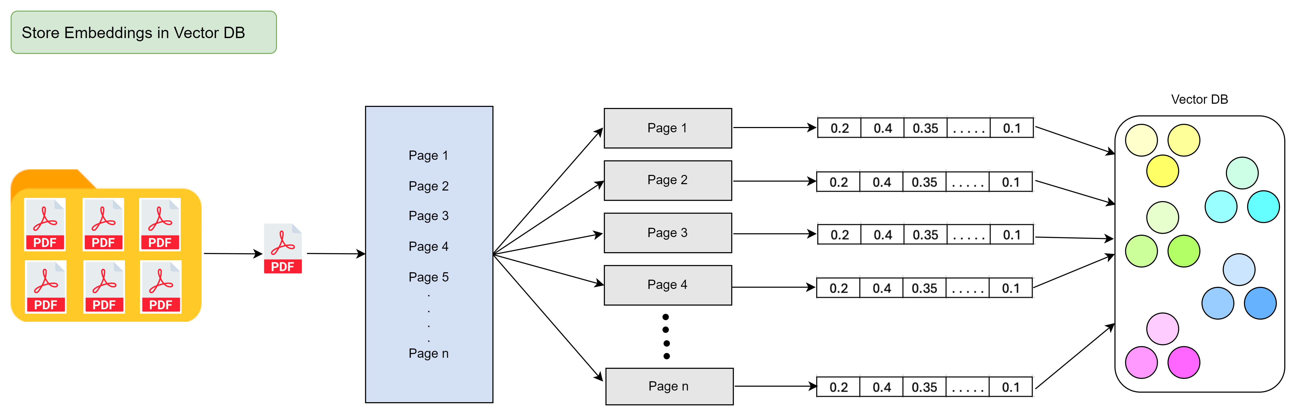
π

Slide 21
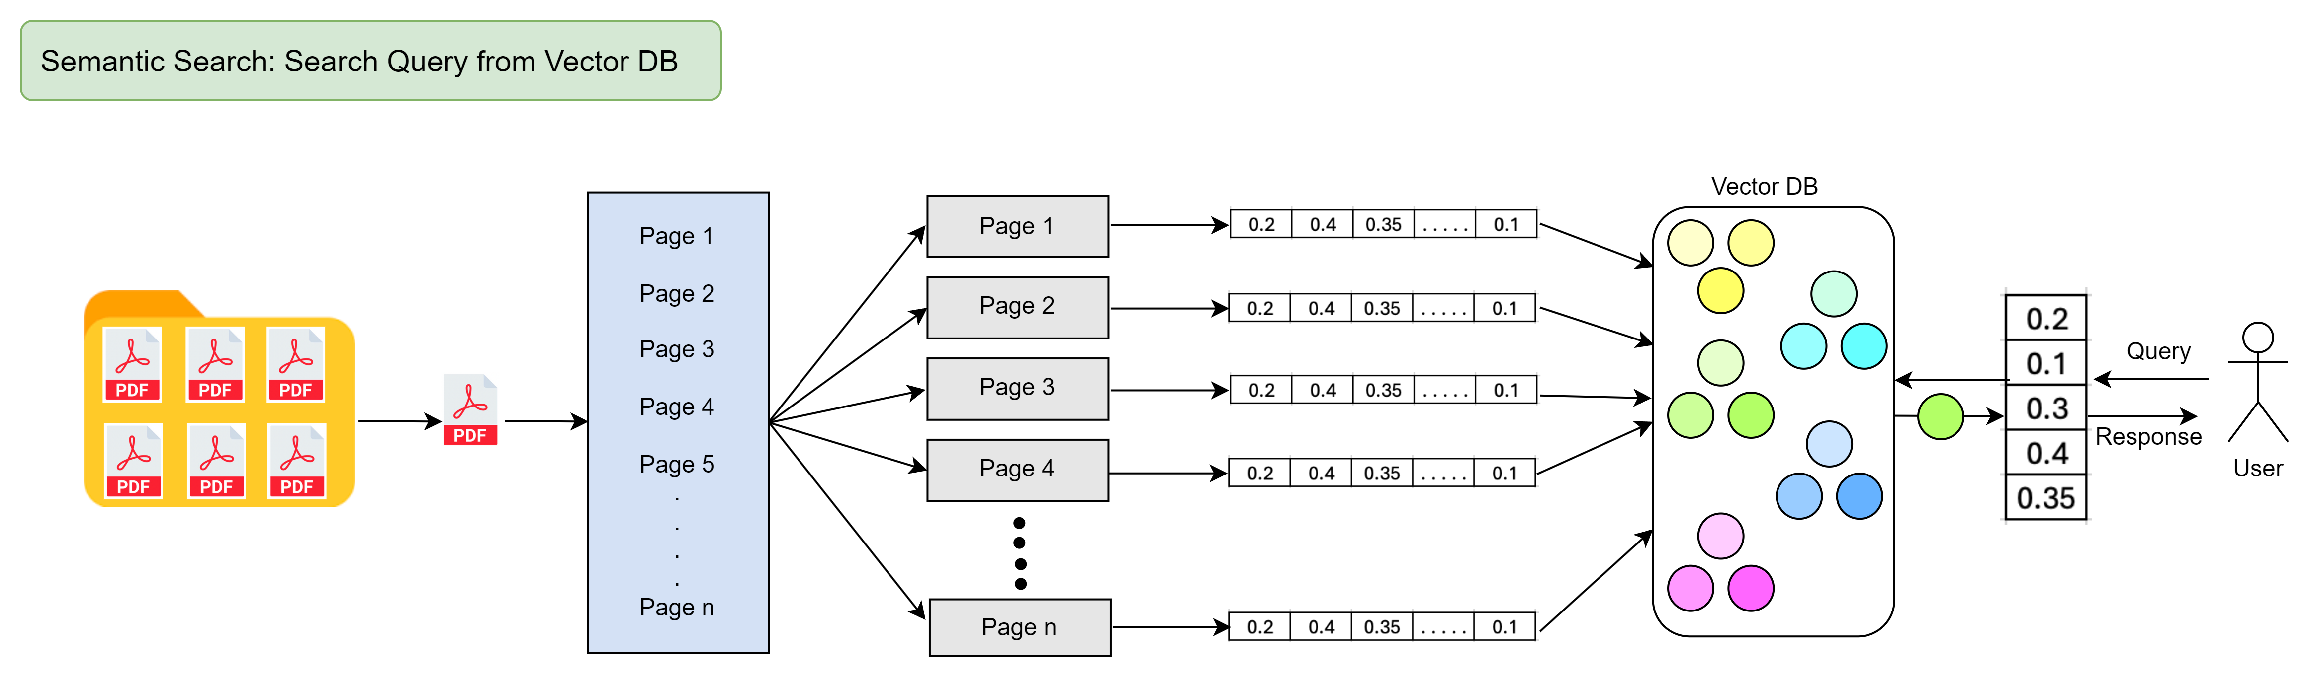
π

Slide 22
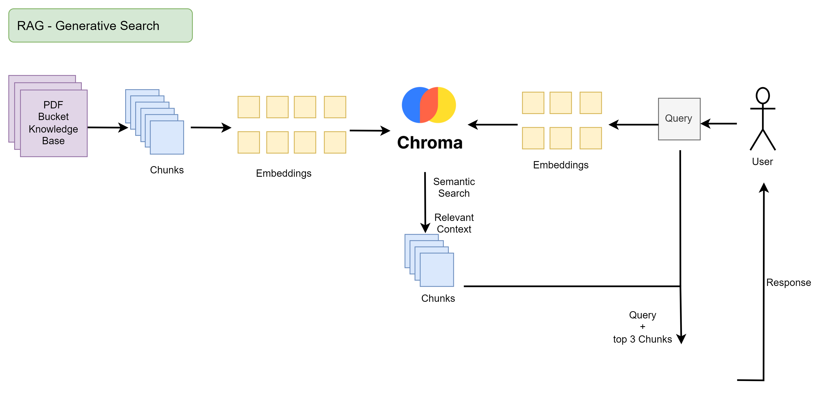
π

Slide 23



π
Communications Channels
WhatsApp: https://whatsapp.com/channel/0029VaOManvEKyZMoPCtPU24
Discord: https://discord.gg/r4pNVqcpCr
LinkedIn: https://www.linkedin.com/company/edquestofficial/

Slide 24


π
Q & A

